Slide 1

ROOMIERADAR-Smart Roommate Finder Portal
by
K NIVEDITHA
Roll No. 224G1A0563
P AJAY KUMAR
Roll No. 224G1A0502
A S SABIHA AFRIN
Roll No. 234G5A0588
Under the guidance of
Dr .S.Sunitha, M.Tech, Ph.D
Assistant Professor
Department of Computer Science and Engineering
Srinivasa Ramanujan Institute of Technology
Autonomous
Rotarypuram Village, B K Samudram Mandal, Ananthapuramu – 515701.
Accredited by NBA & NAAC with “A” Grade,Affiliated to JNTUA,Ananthapuramu
2025-2026

Slide 2
Previous Review Queries
Why web portal instead of mobile app?
What happens if no suitable roommate match is found?
What is the scope of the Roomie Radar application?

Slide 3

Contents
Abstract
Introduction
Literature Survey
Existing System
Proposed System
Planning
Design
Implementation
Research Paper
References
GitHub Link

Slide 4
Abstract
Finding a compatible roommate is difficult due to lifestyle and preference differences.
Traditional methods like social media or manual listings lack structure and security.
Roomie Radar is a web-based platform that automates roommate matching.
Users create profiles and specify lifestyle preferences for better compatibility.
A rule-based algorithm calculates compatibility scores and suggests matches.
The system also supports secure login, room booking, and communication.

Slide 5
Introduction
Shared accommodation has become common for students and working professionals.
Choosing a compatible roommate is important for comfort, productivity, and peaceful living.
Traditional roommate search methods depend on word-of-mouth, social media, or manual listings.
These methods often lack structured evaluation and reliable information.
Roomie Radar is developed to provide a centralized platform for roommate matching.
The system uses preference-based matching to recommend compatible roommates.

Slide 6
Literature Survey
No | Title | Authors | Journal Name & Year | Methodology | key Findings | Gaps
1. | Compatibility-Based Roommate Assignment System | R. Patel, S. Kumar | IJLTEMAS, 2025 | Preference comparison and similarity scoring | Improves roommate selection using compatibility scores | No communication or room booking features
2. | Roommate Allocation System with AI Integration | A. Verma, P. Singh | IJIRT, 2024 | AI-based preference analysis | Automates roommate recommendations | Requires large training datasets
3. | Preference-Based Room Recommendation System | M. Sharma, R. Gupta | IJIRT, 2023 | Recommendation based on user room preferences | Suggests rooms matching user needs | Does not evaluate roommate compatibility
4. | Web-Based Roommate Finder Application | M. Khan, A. Ahmed | IJARCCE, 2020 | Web platform with profile search and filtering | Simplifies online roommate search | No compatibility scoring system

Slide 7
Existing System
The current roommate searching process in many institutions and cities is mostly handled through informal and manual methods such as social media groups, classified advertisements, and personal references.
Key Features:
• Roommate search through social media platforms or online groups
• Basic user information such as gender, budget, and lifestyle preferences is shared through profiles or posts
• Rooms are searched and selected based on room preferences such as location, rent, and facilities
• Some systems use AI or recommendation techniques to suggest potential roommates
Limitations:
Time-consuming manual search process
Many systems focus on room recommendation rather than roommate compatibility
AI-based systems require large datasets for accurate matching
Lack of integrated communication and room booking features

Slide 8
Proposed System
Roomie Radar is a smart web-based platform designed for efficient roommate matching.
Users can register, create profiles, and specify lifestyle and accommodation preferences.
The system uses a rule-based matching algorithm to compare preferences and calculate compatibility scores.
It recommends compatible roommates based on similarity of lifestyle habits.
If suitable roommates are not available, the system suggests available rooms based on preferences.
The platform also provides secure authentication, profile management, and in-system communication.

Slide 9
Planning
Identify the problem of difficulty in finding compatible roommates.
Conduct literature survey to analyze existing roommate matching systems.
Design the system architecture and database structure.
Select technologies such as Django, Python, HTML, CSS, and SQLite.
Develop modules including user registration, preference setup, roommate matching, and room booking.
Test the system and evaluate matching accuracy and performance.

Slide 10
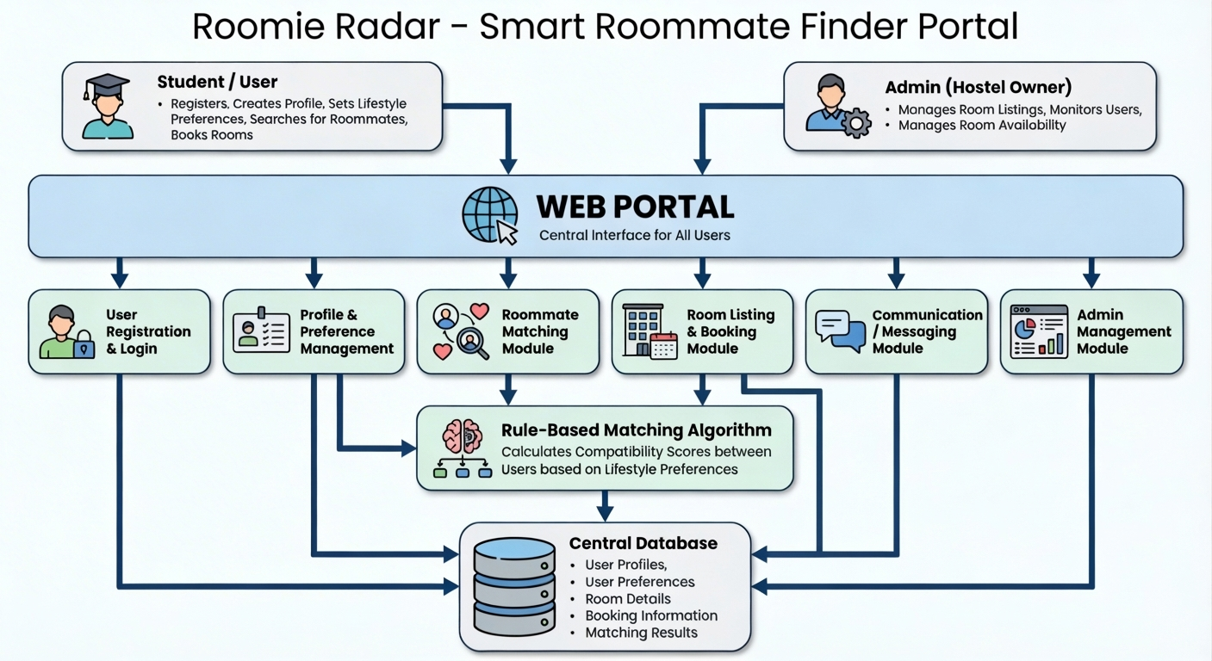
Design
The Roomie Radar – Smart Roommate Finder Portal is designed as a web-based system that connects users and hostel owners through a centralized platform. The system architecture ensures efficient roommate matching, room management, and secure data handling.
1. System Architecture
The system consists of two main users:
Student / User
Registers and logs into the platform
Creates profile and lifestyle preferences
Searches for compatible roommates
Views available rooms and makes bookings
Admin (Hostel Owner)
Manages room listings and availability
Monitors user activities
Handles room management and system administration

Slide 11
Design
2. Functional Modules
The system includes the following modules:
User Registration & Login Module – Handles account creation and authentication.
Profile & Preference Management – Stores user lifestyle preferences for matching.
Roommate Matching Module – Identifies compatible roommates based on preferences.
Room Listing & Booking Module – Displays available rooms and allows booking.
Communication Module – Enables interaction between users.
Admin Management Module – Allows the admin to manage rooms and system data.
3. Matching Mechanism
A rule-based matching algorithm compares user preferences and calculates compatibility scores to recommend suitable roommates.

Slide 12
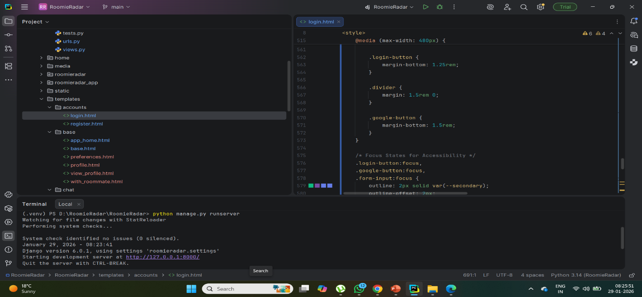
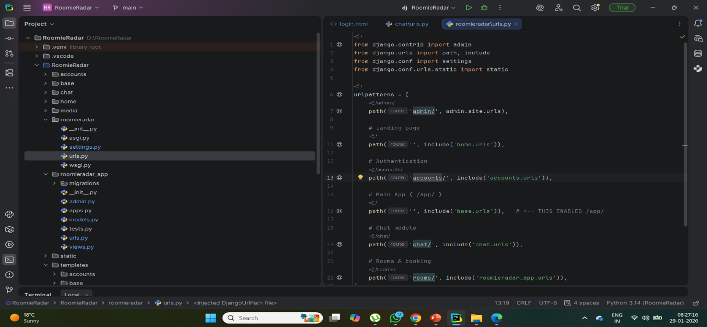
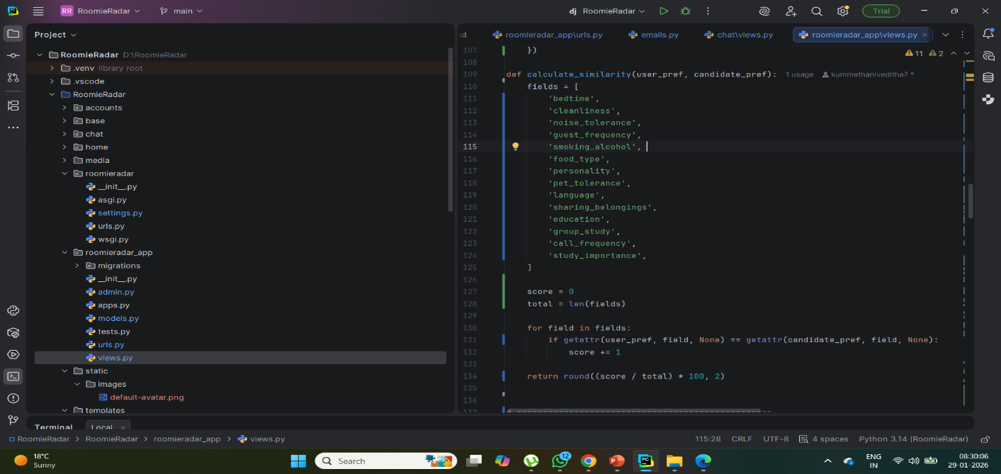
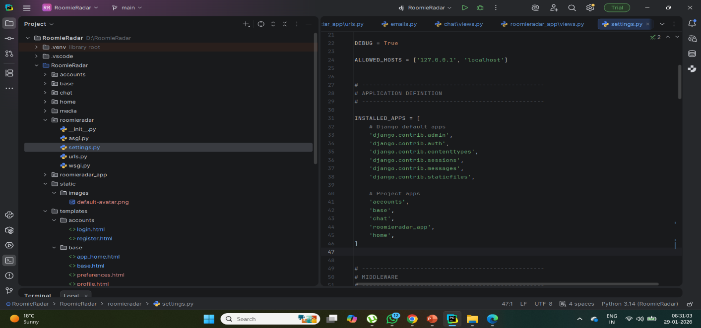
ROOMIERADAR-Smart Roommate Finder Portal
Implementation
A03
DEPT. OF COMPUTER SCIENCE AND ENGINEERING
10
SRINIVASA RAMANUJAN INSTITUTE OF TECHNOLOGY

Slide 13
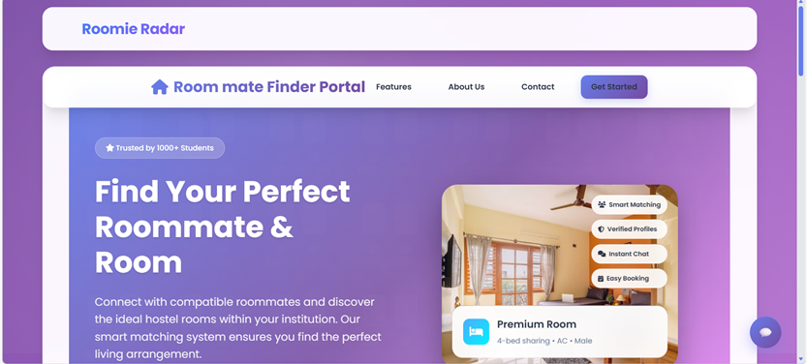
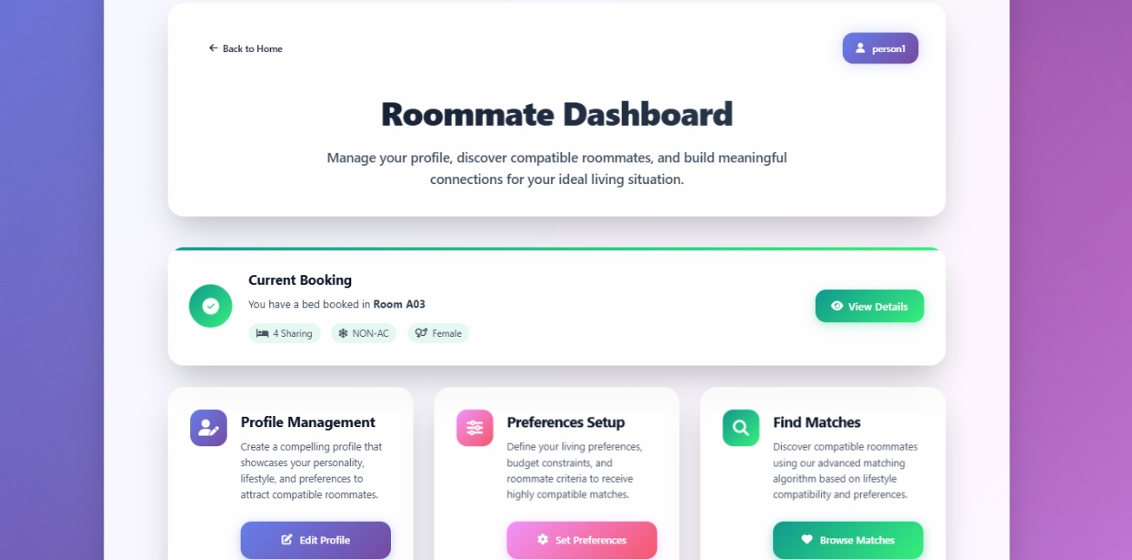
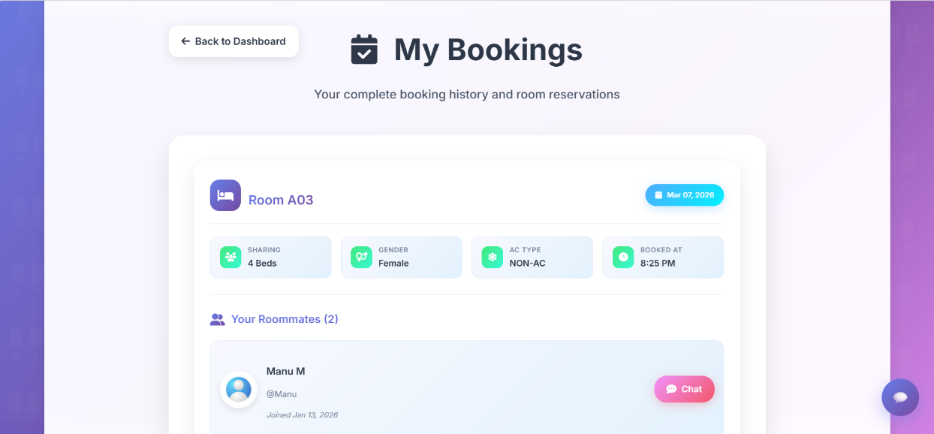
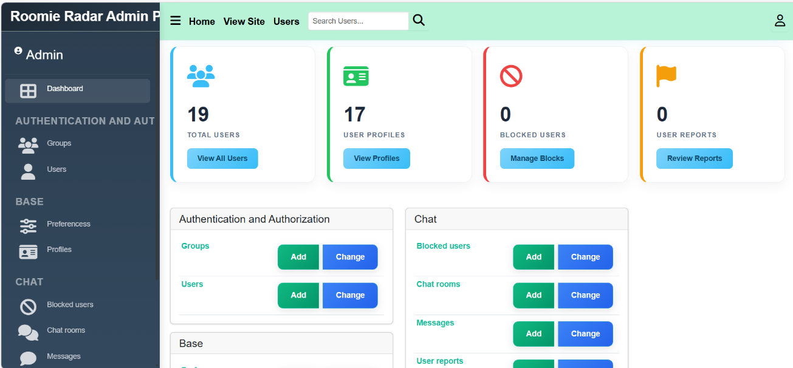
ROOMIERADAR-Smart Roommate Finder Portal
Output
A14
DEPT. OF COMPUTER SCIENCE AND ENGINEERING
17
SRINIVASA RAMANUJAN INSTITUTE OF TECHNOLOGY

Slide 14
Research Paper
Title: Roomie Radar: Smart Roommate Finder Portal
Authors: Dr. S. Sunitha, Niveditha K, Ajay Kumar P, Sabiha Afrin A S
Published by: SCITEPRESS – Science and Technology Publications
Description: The research paper presents the problem statement, system design, and the rule-based roommate matching algorithm used in the proposed system. It also explains the implementation and discusses the experimental outcomes demonstrating the effectiveness of the platform.

Slide 15
References
[1] R. Patel and S. Kumar, “Compatibility-Based Roommate Assignment System,” International Journal of Latest Technology in Engineering, Management & Applied Science (IJLTEMAS), 2025.
[2] A. Verma and P. Singh, “Roommate Allocation System with AI Integration,” International Journal of Innovative Research in Technology (IJIRT), 2024.
[3] M. Sharma and R. Gupta, “Preference-Based Room Recommendation System,” International Journal of Innovative Research in Technology (IJIRT), 2023.
[4] M. Khan and A. Ahmed, “Web-Based Roommate Finder Application,” International Journal of Advanced Research in Computer and Communication Engineering (IJARCCE), 2020.

Slide 16
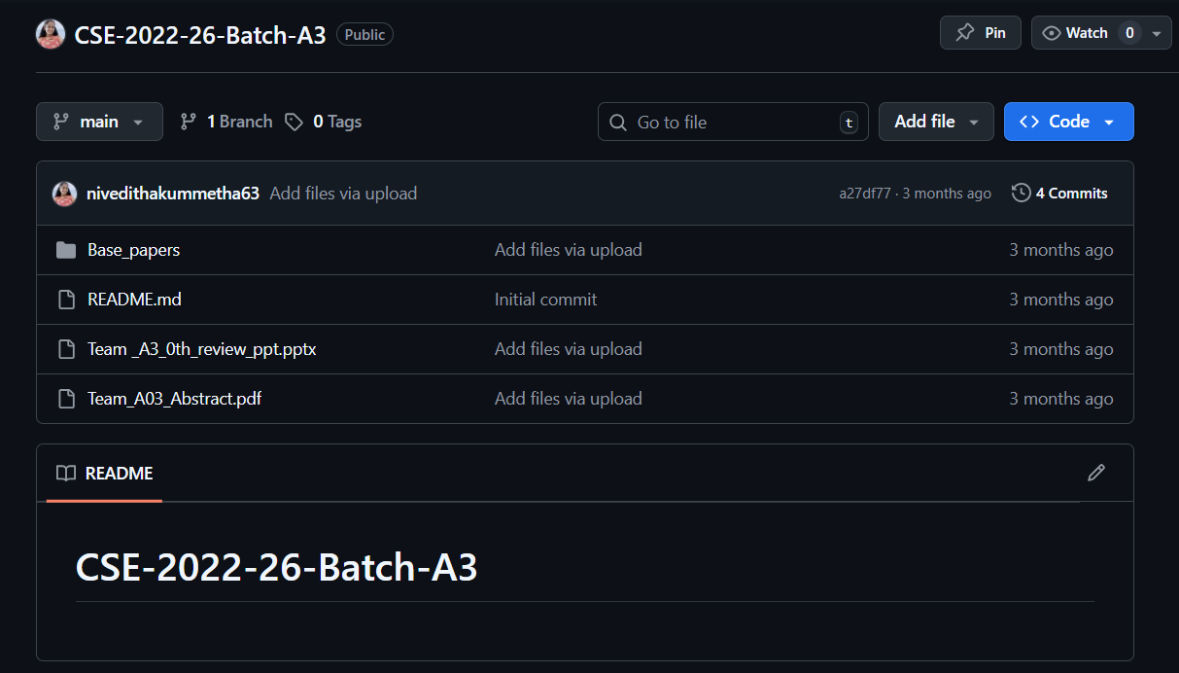
GitHub Link
GitHub Link : https://github.com/nivedithakummetha63/CSE-2022-26-Batch-A3

Slide 17
Thank You!!!

Slide 18
Any Query?

